Slide 1
Project Presentation of Industry Oriented Hands on Experience (22CS422)
On
COGNIX SMART CAMPUSH NAVIGATOR
Suyash Sharma(2210991000)
,Somya Bhatt(2210990861),Kundan Tamsoy(2210991827)
,Abu Ezaan Anjum(2210991174)
Supervised By
Dr. Monika Aggarwal
Department of Computer Science and Engineering,
Chitkara University, Punjab

Slide 2
Introduction
The Problem: Navigating large university or corporate campuses can be confusing and time-consuming for new students, visitors, and even staff.
Limitations of Current Systems: Traditional 2D physical maps or basic web maps lack interactivity, real-time data, and personalized guidance.
The Need: An intelligent, accessible, and modern solution to improve campus accessibility and elevate the overall user experience.
The Project: Cognix is a state-of-the-art "Smart Campus Navigation System" and Digital Twin platform designed to provide an intuitive, real-time, and highly interactive campus experience.
2

Slide 3
Proposed Solution / System Overview
The Concept: A Campus Digital Twin The core proposition of the Cognix project is to transcend traditional, static 2D campus maps by creating a Digital Twin of the campus infrastructure. A digital twin is a dynamic, virtual representation of a physical environment. Instead of just showing where a building is, Cognix provides an interactive layer on top of the physical geography, allowing users to interact with campus facilities, view real-time data, and receive intelligent guidance through a unified web interface.
System Architecture To deliver this experience seamlessly across devices, Cognix is built on a robust, modern Client-Server Architecture:
The Interactive Client (Frontend):
User Interface: The user-facing application is a highly responsive Single Page Application (SPA). It acts as the interactive map viewer and the primary interface for all features.
Welcome Overlay: The experience begins with an engaging entry point that masks the complex background loading processes and transitions smoothly into the "Explore Campus" view.
Dynamic Rendering: Instead of reloading pages, the client dynamically renders map segments, search results, and chatbot overlays on the fly, ensuring a fluid, app-like experience.
The Processing Server (Backend):
API Gateway: A centralized backend server handles all incoming requests from the frontend, securely managing data flow.
Logic Engine: It processes complex tasks such as executing navigation routing algorithms (calculating the shortest/most accessible path between Point A and Point B) and processing search queries from the Command Palette.
AI Integration: The backend acts as the bridge to the Natural Language Processing (NLP) models, taking user voice or text input from the chatbot, interpreting the intent, and returning contextual answers or navigation commands.
Data Flow and Management
Structured Campus Data: The system relies on meticulously structured data sets (e.g., JSON pipelines) that define the coordinates of buildings, rooms, amenities, and ongoing events.
Real-Time Data Integration: The architecture is designed to ingest and display dynamic data. For instance, the Crowd Density Heatmap processes real-time metrics to visually indicate high-traffic areas, allowing the system to suggest alternative, less congested routes.
The User Journey
Assistance: If they are unsure what to search for, they activate the AI Chatbot via Voice, asking, "Where is the nearest accessible restroom?"
3

Slide 4
Key Features or Functionality
Interactive Navigation & Routing: Accessible and efficient pathfinding to help users locate specific buildings, departments, and amenities.
AI-Powered Chatbot with Voice Input: A modernized intelligent assistant featuring voice recognition and rich UI components to dynamically answer questions.
Command-Palette Search: A lightning-fast, global search feature (similar to Spotlight/Alfred) for instantly finding locations, faculty, or upcoming events.
Real-Time Crowd Density Heatmap: Visually highlights busy areas on campus, allowing users to avoid congestion and optimize their routes.
Analytics Dashboard: A real-time administrative dashboard providing insights into campus usage, popular search trends, and system performance.
Step-by-Step Visual Guidance: Provides clear, step-by-step visual pathways with directional cues directly on the digital map to ensure users don't get lost.
Dynamic Map Layers: Allows users to toggle specific map overlays to instantly find essential facilities like restrooms, cafeterias, parking, and wheelchair-accessible ramps.
Live Event Discovery: Integrates with campus schedules to highlight ongoing or upcoming events (like seminars or sports matches) directly on the interactive map.
Cross-Platform Responsiveness: A mobile-first design architecture ensuring the platform functions flawlessly across smartphones, tablets, and desktop computers without losing graphical fidelity.
Premium Interactive UI: Features an engaging "Welcome Overlay," smooth micro-animations, and a sleek dark mode option that elevates the user experience to an investor-grade standard.
4

Slide 5
Tools and Technology
Frontend (User Interface): React.js / Vite for a dynamic Single Page Application, styled with modern CSS/Tailwind CSS for a premium, responsive design.
Backend (Server): Node.js and Express.js to handle robust API requests, routing logic, and backend processing.
AI & Search Capabilities: Natural Language Processing (NLP) integration for the chatbot and advanced algorithms for the command-palette search.
Data Management: Structured JSON data pipelines (e.g., handling events and location metadata) and efficient state management.
Deployment: Hosted on production-ready cloud platforms (Vercel for the Frontend, Render for the Backend).
5

Slide 6
Implementation
Phase 1 - Project Foundation & Data Mapping: We started by gathering comprehensive data on the campus layout. We mapped the infrastructure, identified key points of interest, and built the core user interface of the digital twin, ensuring a strong architectural foundation using React and Node.js.
Phase 2 - Core Functionality & Logic: Focused on backend algorithms. We developed the complex navigation routing algorithms to ensure accurate pathfinding. Simultaneously, we implemented the global command-palette search, structuring the database for rapid query responses.
Phase 3 - AI Integration & Voice Capabilities: A major technical milestone where we integrated Natural Language Processing (NLP). We trained the intelligent chatbot system to understand campus-specific context, enabled voice input for accessibility, and connected the bot directly to our live campus data.
Phase 4 - Advanced Features & Real-Time Data: Shifted focus to data visualization and analytics. We implemented the real-time crowd density heatmap to visualize traffic flow and built the administrative analytics dashboard to monitor system health and user behavior.
Phase 5 - Optimization, Testing & Deployment: The final polish phase. We conducted rigorous cross-device testing to fix responsive UI bugs, optimized load times, and deployed the frontend to Vercel and the backend to Render, ensuring a production-ready, public-facing application.
6

Slide 7
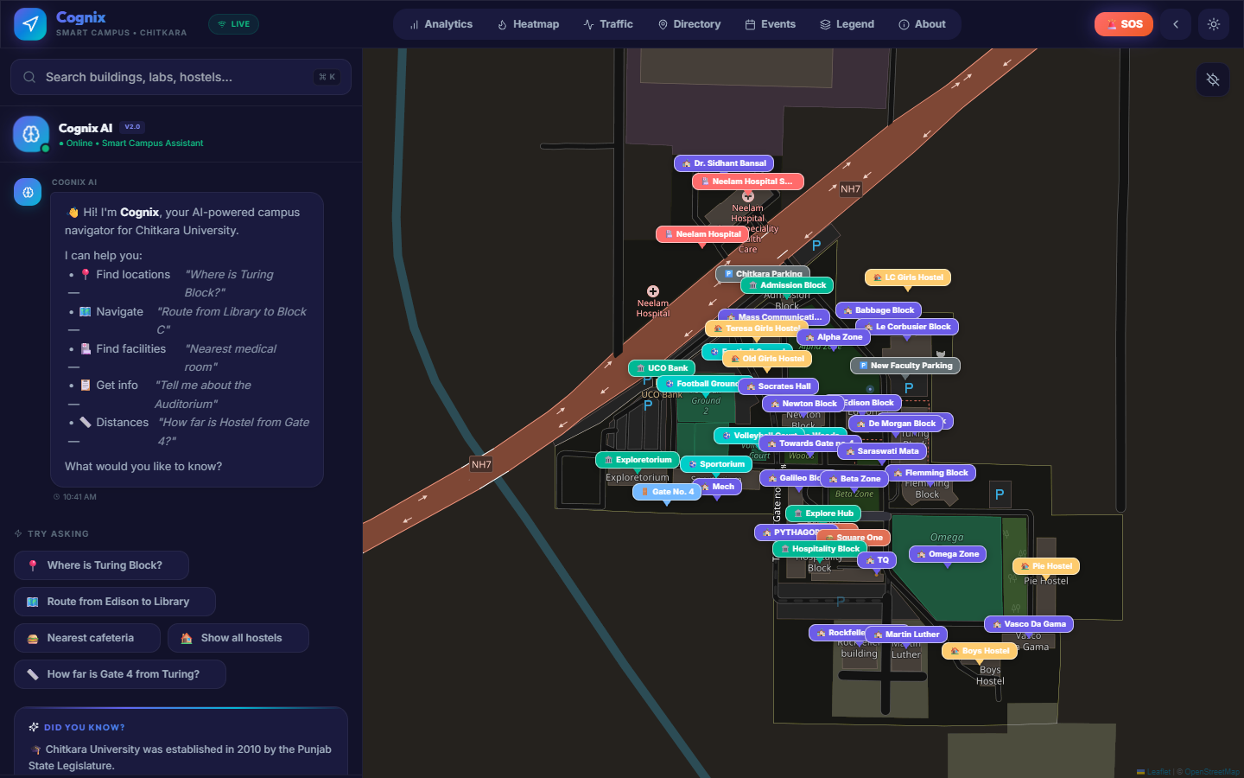

Slide 8
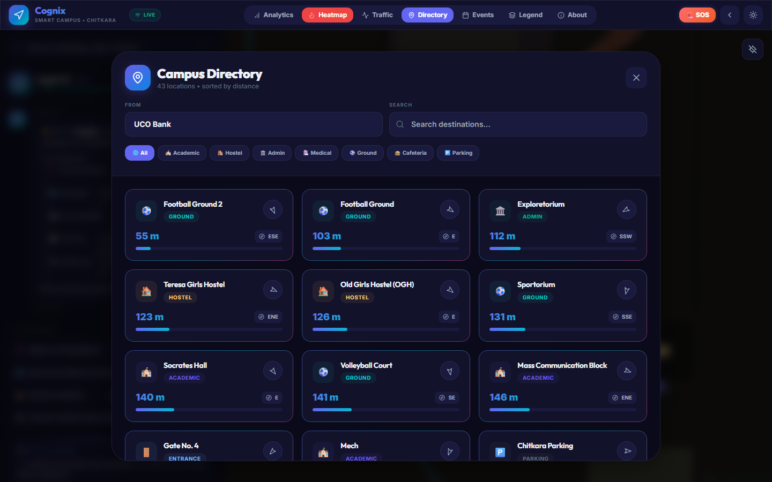

Slide 9
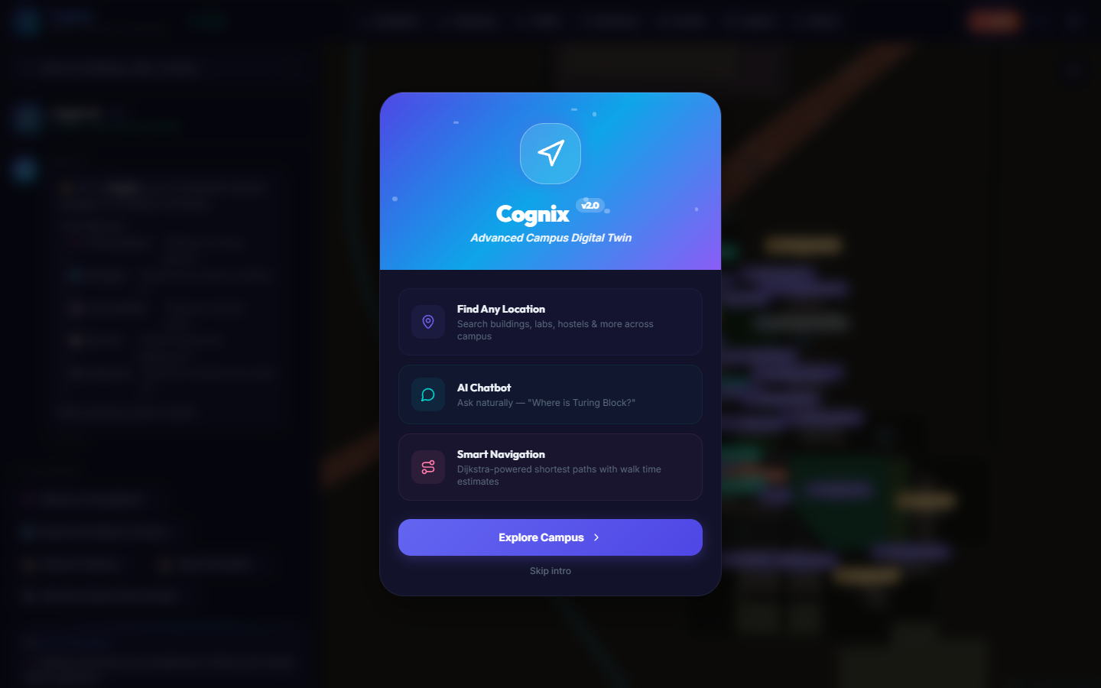

Slide 11


Slide 12
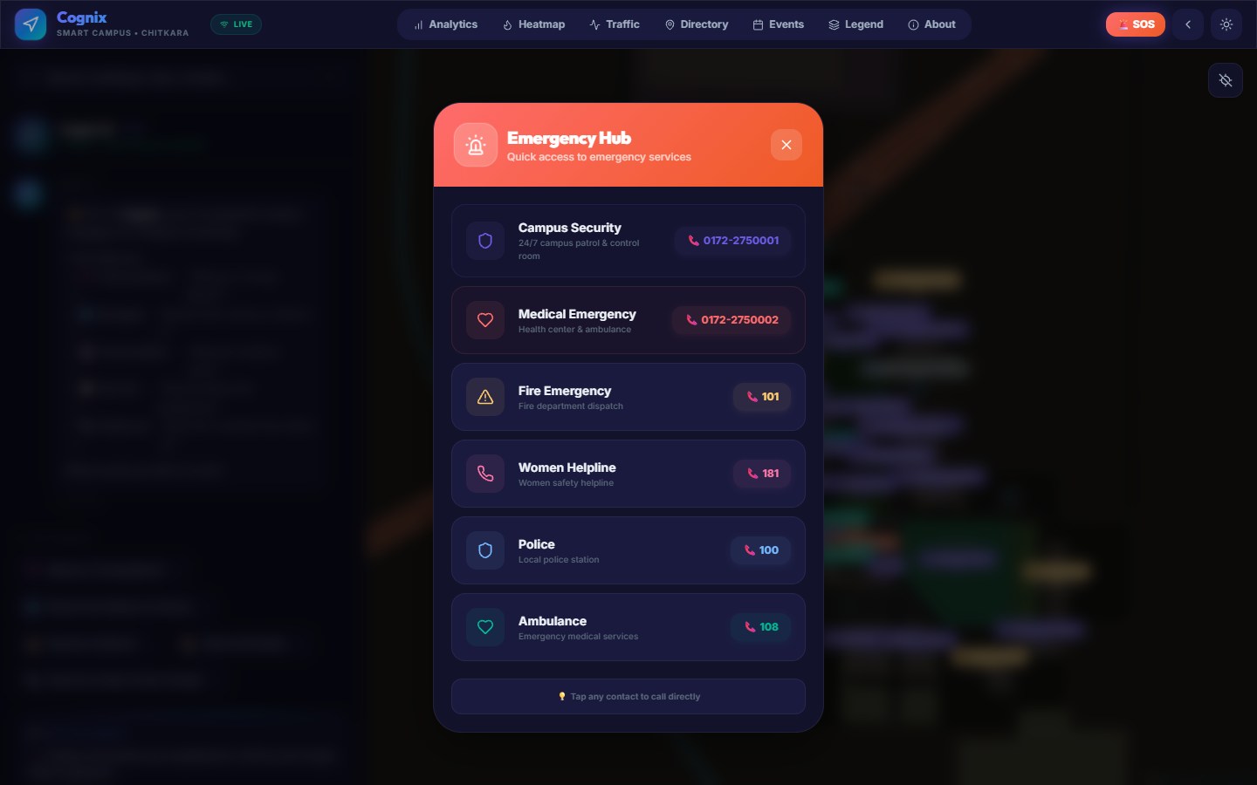

Slide 13
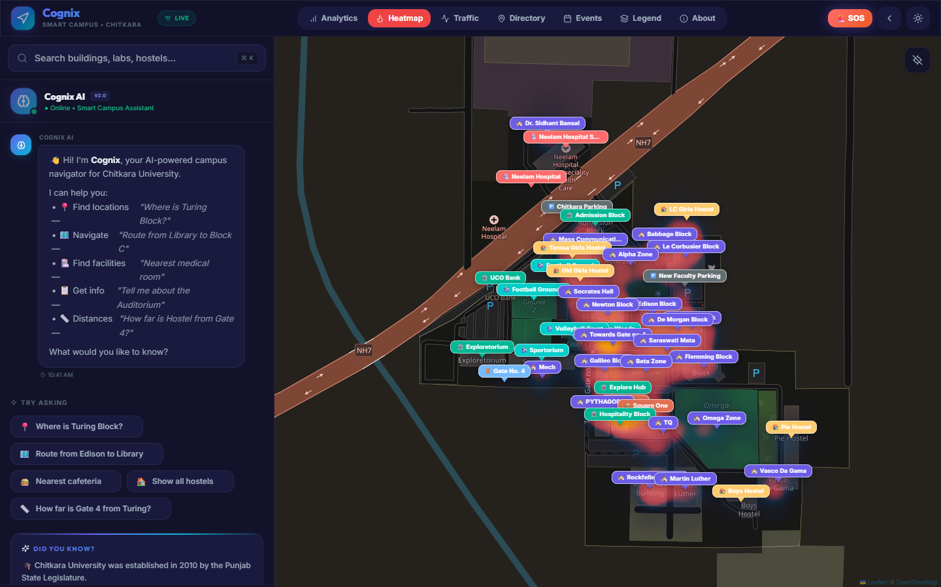

Slide 14
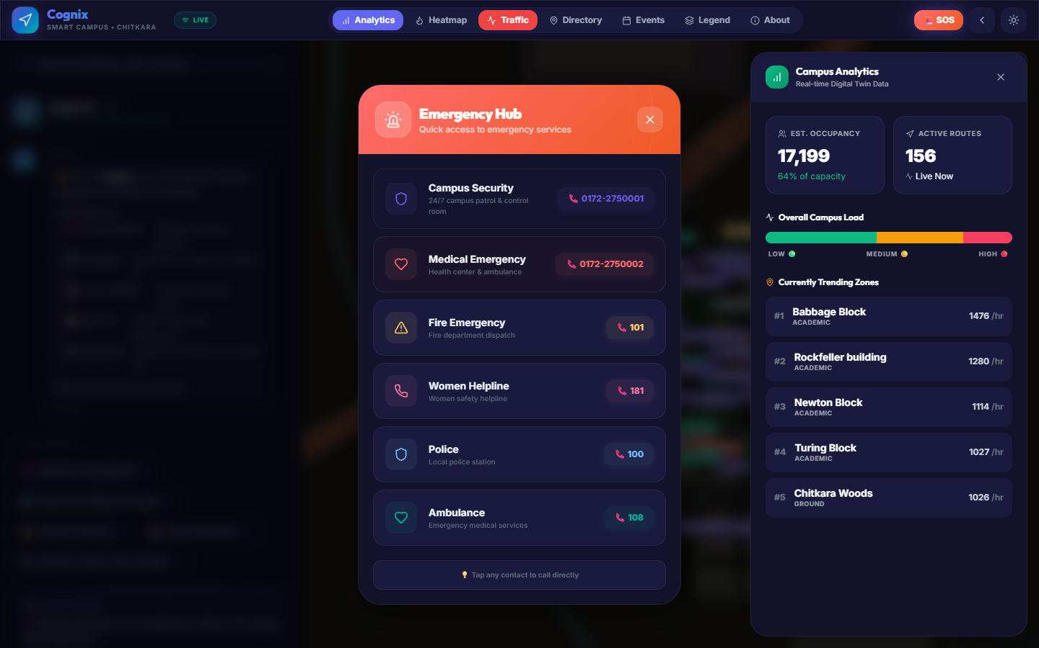

Slide 15
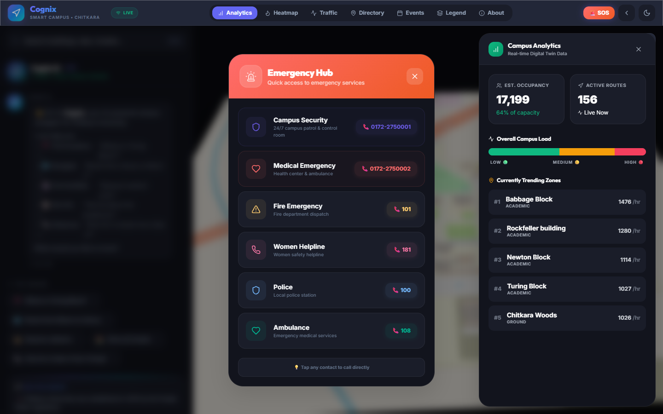

Slide 16
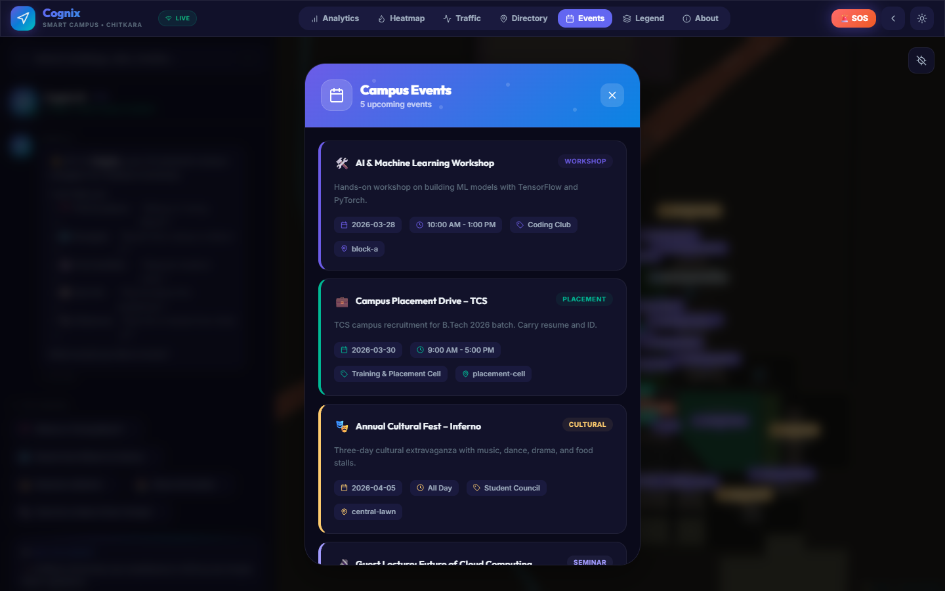

Slide 17
Conclusion
A Modernized, Digital-First Experience: Cognix successfully bridges the gap between physical infrastructure and digital convenience. By transforming outdated, static campus maps into an interactive digital twin, we have created a modern tool that meets the expectations of today’s tech-savvy users.
Significantly Enhanced Accessibility: The platform drastically reduces the friction of navigating a large campus. Aided by an AI voice assistant and real-time insights, we have made it significantly easier for new students, faculty, and visitors to find their way around confidently and efficiently.
Scalable, Investor-Ready Architecture: Built with modern web standards (the MERN/Vite stack) and deployed on robust cloud platforms, the system is not just a prototype; it is highly scalable, secure, and ready for real-world, high-traffic usage.
Expansive Future Scope: The foundation is laid for future innovation. Potential next steps include integrating live IoT sensors (e.g., smart cameras or Wi-Fi data) for hyper-accurate real-time crowd data, introducing AR (Augmented Reality) navigation through mobile cameras, and licensing the platform for expansion to other universities and corporate campuses.
17

Slide 18
Thank You
18

